Slide 1


The PiXL Club The PiXL Club The PiXL Club The PiXL Club The PiXL Club The PiXL Club The PiXL Club The PiXL Club The PiXL Club The PiXL Club The PiXL Club The PiXL Club The PiXL Club The PiXL Club The PiXL Club The PiXL Club The PiXL Club The PiXL Club The PiXL Club The PiXL Club The PiXL Club The PiXL Club The PiXL Club The PiXL Club The PiXL Club The PiXL Club The PiXL Club The PiXL Club The PiXL Club The PiXL Club The PiXL Club The PiXL Club The PiXL Club The PiXL Club The PiXL Club The PiXL Club The PiXL Club The PiXL Club The PiXL Club The PiXL Club The PiXL Club The PiXL Club The PiXL Club The PiXL Club The PiXL Club XL Club The PiXL Club The PiXL Club The PiXL Club The PiXL Club The PiXL Club The PiXL Club The PiXL Club The PiXL Club The PiXL Club The PiXL Club The PiXL Club The PiXL Club The PiXL Club The PiXL Club The PiXL Club The PiXL Club The PiXL Club The PiXL Club The PiXL Club The PiXL Club The PiXL Club The PiXL Club The PiXL Club The PiXL Club The PiXL Club The PiXL Club The PiXL Club The PiXL Club The PiXL Club The PiXL Club The PiXL Club The PiXL Club The PiXL Club The PiXL Club The PiXL Club The PiXL Club The PiXL Club The PiXL Club The PiXL Club The PiXL Club The PiXL Club The PiXL Club The PiXL Club The PiXL Club The PiXL Club The PiXL Club The PiXL Club The PiXL Club The PiXL Club The PiXL Club The PiXL Club The PiXL Club The PiXL Club The PiXL Club The PiXL Club The PiXL Club The PiXL Club The PiXL Club The PiXL Club The PiXL Club The PiXL Club The PiXL Club The PiXL Club The PiXL Club The PiXL Club The PiXL Club The PiXL Club The PiXL Club The PiXL Club The PiXL Club The PiXL Club The PiXL Club The PiXL Club The PiXL Club The PiXL Club The PiXL Club The PiXL Club The PiXL Club The PiXL Club The PiXL Club The PiXL Club The PiXL Club The PiXL Club The PiXL Club The PiXL Club The PiXL Club The PiXL Club The PiXL Club The PiXL Club The PiXL Club The PiXL Club The PiXL Club The PiXL Club The PiXL Club The PiXL Club The PiXL Club The PiXL Club The PiXL Club The PiXL Club The PiXL Club The PiXL Club The PiXL Club The PiXL Club The PiXL Club The PiXL Club The PiXL Club The PiXL Club The PiXL Club The PiXL Club The PiXL Club The PiXL Club The PiXL Club The PiXL Club The PiXL Club The PiXL Club The PiXL Club The PiXL Club The PiXL Club The PiXL Club The PiXL Club The PiXL Club The PiXL Club The PiXL Club The PiXL Club The PiXL Club The PiXL Club The PiXL Club The PiXL Club The PiXL Club The PiXL Club The PiXL Club The PiXL Club The PiXL Club The PiXL Club The PiXL Club The PiXL Club The PiXL Club The PiXL Club The PiXL Club The PiXL Club The PiXL Club The PiXL Club The PiXL Club The PiXL Club The PiXL Club The PiXL Club The PiXL Club The PiXL Club The PiXL Club The PiXL Club The PiXL Club The PiXL Club The PiXL Club The PiXL Club The PiXL Club The PiXL Club The PiXL Club The PiXL Club The PiXL Club The PiXL Club The PiXL Club The PiXL Club The PiXL Club The PiXL Club The PiXL Club The PiXL Club The PiXL Club The PiXL Club The PiXL Club The PiXL Club The PiXL Club The PiXL Club The PiXL Club The PiXL Club The PiXL Club The PiXL Club The PiXL Club The PiXL Club The PiXL Club The PiXL Club The PiXL Club The PiXL Club The PiXL Club The PiXL Club The PiXL Club The PiXL Club The PiXL Club The PiXL Club The PiXL Club The PiXL Club The PiXL Club The PiXL Club The PiXL Club The PiXL Club The PiXL Club The PiXL Club The PiXL Club The PiXL Club The PiXL Club The PiXL Club The PiXL Club The PiXL Club The PiXL Club The PiXL Club The PiXL Club The PiXL Club The PiXL Club The PiXL Club The PiXL Club The PiXL Club The PiXL Club The PiXL Club The PiXL Club The PiXL Club The PiXL Club The PiXL Club The PiXL Club The PiXL Club The PiXL Club The PiXL Club The PiXL Club The PiXL Club The PiXL Club The PiXL Club The PiXL Club The PiXL Club The PiXL Club The PiXL Club The PiXL Club The PiXL Club The PiXL Club The PiXL Club The PiXL Club The PiXL Club The PiXL Club The PiXL Club The PiXL Club The PiXL Club The PiXL Club The PiXL Club The PiXL Club The PiXL Club The PiXL Club The PiXL Club The PiXL Club The PiXL Club The PiXL Club The PiXL Club The PiXL Club The PiXL Club The PiXL Club The PiXL Club The PiXL Club The PiXL Club The PiXL Club The PiXL Club The PiXL Club The PiXL Club The PiXL Club The PiXL Club The PiXL Club The PiXL Club The PiXL Club The PiXL Club The PiXL Club The PiXL Club The PiXL Club The PiXL Club The PiXL Club The PiXL Club The PiXL Club The PiXL Club The PiXL Club The PiXL Club The PiXL Club The PiXL Club The PiXL Club The PiXL Club The PiXL Club The PiXL Club The PiXL Club The PiXL Club The PiXL Club The PiXL Club The PiXL Club The PiXL Club The PiXL Club The PiXL Club The PiXL Club The PiXL Club The PiXL Club The PiXL Club The PiXL Club The PiXL Club The PiXL Club The PiXL Club The PiXL Club The PiXL Club The PiXL Club The PiXL Club The PiXL Club The PiXL Club The PiXL Club The PiXL Club The PiXL Club The PiXL Club The PiXL Club The PiXL Club The PiXL Club The PiXL Club The PiXL Club The PiXL Club The PiXL Club The PiXL Club The PiXL Club The PiXL Club The PiXL Club The PiXL Club The PiXL Club The PiXL Club The PiXL Club The PiXL Club The PiXL Club The PiXL Club The PiXL Club The PiXL Club The PiXL Club The PiXL Club The PiXL Club The PiXL Club The PiXL Club The PiXL Club The PiXL Club The PiXL Club The PiXL Club The PiXL Club The PiXL Club The PiXL Club The PiXL Club The PiXL Club The PiXL Club The PiXL Club The PiXL Club The PiXL Club The PiXL Club The PiXL Club The PiXL Club The PiXL Club The PiXL Club The PiXL Club The PiXL Club The PiXL Club The PiXL Club The PiXL Club The PiXL Club The PiXL Club The PiXL Club The PiXL Club The PiXL Club The PiXL Club The PiXL Club The PiXL Club The PiXL Club The PiXL Club The PiXL Club The PiXL Club The PiXL Club The PiXL Club The PiXL Club The PiXL Club The PiXL Club The PiXL Club The PiXL Club The PiXL Club The PiXL Club The PiXL Club The PiXL Club The PiXL Club The PiXL Club The PiXL Club The PiXL Club The PiXL Club The PiXL Club The PiXL Club The PiXL Club The PiXL Club The PiXL Club The PiXL Club The PiXL Club The PiXL Club The PiXL Club The PiXL Club The PiXL Club The PiXL Club The PiXL Club The PiXL Club The PiXL Club The PiXL Club The PiXL Club The PiXL Club The PiXL Club The PiXL Club The PiXL Club The PiXL Club The PiXL Club The PiXL Club The PiXL Club The PiXL Club The PiXL Club The PiXL Club The PiXL Club The PiXL Club The PiXL Club The PiXL Club The PiXL Club The PiXL Club The PiXL Club The PiXL Club The PiXL Club The PiXL Club The PiXL Club The PiXL Club The PiXL Club The PiXL Club The PiXL Club The PiXL Club The PiXL Club The PiXL Club The PiXL Club The PiXL Club The PiXL Club The PiXL Club The PiXL Club The PiXL Club The PiXL Club The PiXL Club The PiXL Club The PiXL Club The PiXL Club The PiXL Club The PiXL Club The PiXL Club The PiXL Club The PiXL Club The PiXL Club The PiXL Club The PiXL Club The PiXL Club The PiXL Club The PiXL Club The PiXL Club The PiXL Club The PiXL Club The PiXL Club The PiXL Club The PiXL Club The PiXL Club The PiXL Club The PiXL Club The PiXL Club The PiXL Club The PiXL Club The PiXL Club The PiXL Club The PiXL Club The PiXL Club The PiXL Club The PiXL Club The PiXL Club The PiXL Club The PiXL Club The PiXL Club The PiXL Club The PiXL Club The PiXL Club The PiXL Club The PiXL Club The PiXL Club The PiXL Club The PiXL Club The PiXL Club The PiXL Club The PiXL Club The PiXL Club The PiXL Club The PiXL Club The PiXL Club The PiXL Club The PiXL Club The PiXL Club The PiXL Club The PiXL Club The PiXL Club The PiXL Club The PiXL Club The PiXL Club The PiXL Club The PiXL Club The PiXL Club The PiXL Club The PiXL Club The PiXL Club The PiXL Club The PiXL Club The PiXL Club The PiXL Club The PiXL Club The PiXL Club The PiXL Club The PiXL Club The PiXL Club The PiXL Club The PiXL Club The PiXL Club The PiXL Club The PiXL Club The PiXL Club The PiXL Club The PiXL Club The PiXL Club The PiXL Club The PiXL Club The PiXL Club The PiXL Club The PiXL Club The PiXL Club The PiXL Club The PiXL Club The PiXL Club The PiXL Club The PiXL Club The PiXL Club The PiXL Club The PiXL Club The PiXL Club The PiXL Club The PiXL Club The PiXL Club The PiXL Club The PiXL Club The PiXL Club The PiXL Club The PiXL Club The PiXL Club The PiXL Club The PiXL Club The PiXL Club The PiXL Club The PiXL Club The PiXL Club The PiXL Club The PiXL Club The PiXL Club The PiXL Club The PiXL Club The PiXL Club The PiXL Club The PiXL Club The PiXL Club The PiXL Club The PiXL Club The PiXL Club The PiXL Club The PiXL Club The PiXL Club The PiXL Club The PiXL Club The PiXL Club The PiXL Club The PiXL Club The PiXL Club The PiXL Club The PiXL Club The PiXL Club The PiXL Club The PiXL Club The PiXL Club The PiXL Club The PiXL Club The PiXL Club The PiXL Club The PiXL Club The PiXL Club The PiXL Club The PiXL Club The PiXL Club The PiXL Club The PiXL Club The PiXL Club The PiXL Club The PiXL Club The PiXL Club The PiXL Club The PiXL Club The PiXL Club The PiXL Club The PiXL Club The PiXL Club The PiXL Club The PiXL Club The PiXL Club The PiXL Club The PiXL Club The PiXL Club The PiXL Club The PiXL Club The PiXL Club The PiXL Club The PiXL Club The PiXL Club The PiXL Club The PiXL Club The PiXL Club The PiXL Club The PiXL Club The PiXL Club The PiXL Club The PiXL Club The PiXL Club The PiXL Club The PiXL Club The PiXL Club The PiXL Club The PiXL Club The PiXL Club The PiXL Club The PiXL Club The PiXL Club The PiXL Club The PiXL Club The PiXL Club The PiXL Club The PiXL Club The PiXL Club The PiXL Club The PiXL Club The PiXL Club The PiXL Club The PiXL Club The PiXL Club The PiXL Club The PiXL Club The PiXL Club The PiXL Club The PiXL Club The PiXL Club The PiXL Club The PiXL Club The PiXL Club The PiXL Club The PiXL Club The PiXL Club The PiXL Club The PiXL Club The PiXL Club The PiXL Club The PiXL Club The PiXL Club The PiXL Club The PiXL Club The PiXL Club The PiXL Club The PiXL Club The PiXL Club The PiXL Club The PiXL Club The PiXL Club The PiXL Club The PiXL Club The PiXL Club The PiXL Club The PiXL Club The PiXL Club The PiXL Club The PiXL Club The PiXL Club The PiXL Club The PiXL Club The PiXL Club The PiXL Club The PiXL Club The PiXL Club The PiXL Club The PiXL Club The PiXL Club The PiXL Club The PiXL Club The PiXL Club The PiXL Club The PiXL Club The PiXL Club The PiXL Club The PiXL Club The PiXL Club The PiXL Club The PiXL Club The PiXL Club The PiXL Club The PiXL Club The PiXL Club
PiXL KnowIT!
GCSE Chemistry
AQA Topic – Atomic structure and the periodic table
© Copyright The PiXL Club Ltd, 2017
This resource is strictly for the use of member schools for as long as they remain members of The PiXL Club. It may not be copied, sold nor transferred to a third party or used by the school after membership ceases. Until such time it may be freely used within the member school.
All opinions and contributions are those of the authors. The contents of this resource are not connected with nor endorsed by any other company, organisation or institution.
www.pixl.org.uk The PiXL Club Ltd, Company number 07321607

Slide 2
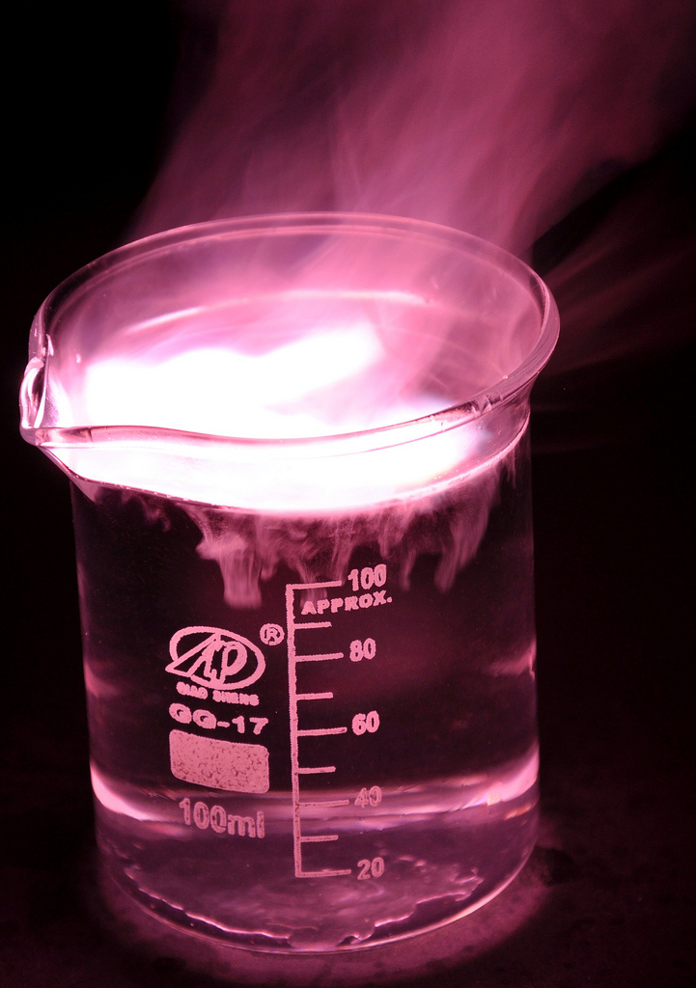
Overview
Atomic structure and the periodic table
Atoms, elements, compounds and mixtures
  Atoms, elements and compounds
  Word and symbol equations
  Separation techniques
Atomic model
  History of the atomic model
  Size and mass of atoms
  Atomic structure
Periodic table
  History of the periodic table
  Group 0, group 1 and group 7
  Transition metals (chemistry only)
Notes:
https://c2.staticflickr.com/4/3178/4076380768_03994aed44_b.jpg

Slide 3

LearnIT!
KnowIT!
Atoms, elements,
compounds and
mixtures PART 1
  Atoms, elements and compounds
  Word and symbol equations

Slide 4
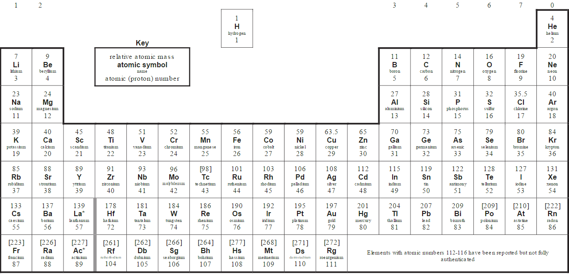
  Atoms, elements, compounds and mixtures - PART 1
All substances are made of atoms that cannot be chemically broken down. It is the smallest part of an element.
Elements are made of only one type of atom. Each element has its own symbol.
e.g. Na is sodium.
There are about 100 different elements
Compounds contain more than one type of atom. They are formed from elements by chemical reactions, which always involve the formation of one or more new substance, often involving an energy change.
The components of a compound cannot be separated by physical means. They can be separated only by chemical means.
You need to:
Know the names and symbols for the first 20 elements and all of group 1, 7 and 0
Name compounds when given the formulae or symbol equations
MgCl₂
magnesium
chlorine
Magnesium chloride

Slide 5
  Atoms, elements, compounds and mixtures - PART 1
Compounds contain two or more elements chemically combined in fixed proportions and can be represented by formulae using the symbols of atoms from which they formed.
For example:
Na₂S = sodium sulfide
K₂O = potassium oxide
Naming a compound with two elements (usually a metal and a non metal) apply these rules:
The metal name does not change
The non-metal's name ends in ide
When a compound contains a transition metal, the names become a bit more complicated. To distinguish them, Roman numerals indicate the charge on the metal ion
e.g. iron(II) chloride.
Naming a compound with a metal that reacts with ions that consist of two or more non-metal atoms covalently bonded together apply these rules:
The metal name does not change
The non-metal's name ends in ate if oxygen is present
For example: Na₂CO₃ = sodium carbonate
KNO₃ = potassium nitrate

Slide 6
  Atoms, elements, compounds and mixtures - PART 1
Chemical equations: Show the reactants (what we start with) and the products (what we end with).
No atoms are lost or made. The mass of the products equals the mass of the reactants.
You need to:
Write word equations
Balanced symbol equations
Word equation: methane + oxygen → carbon dioxide + water
Symbol equation: CH₄ + 2O₂ → CO₂ + 2H₂O
There are 4 hydrogens here, bonded together.
There are 2 molecules of oxygen not bonded together.
There are 4 hydrogens here. You multiply the big number by the little number.
+
+
Equations MUST balance
We can ONLY add BIG numbers to the front of a substance
We can tell elements within a compound by BIG letters
We can check an equation is balanced by counting the number of each type of atom on either side

Slide 7
  Atoms, elements, compounds and mixtures - PART 1
We can add state symbols to a symbol equation to show whether the reactants and products in a chemical reaction are solids, gases, liquids or dissolved in water.
Solid = s
Liquid = l
Gas = g
Aqueous (dissolved in water) = aq
Word equation: sodium + water → sodium hydroxide + hydrogen
Symbol equation: 2Na(s) + 2H₂O(l) → 2NaOH(aq) + H₂(g)
The reaction between copper sulfate and sodium hydroxide is:
copper sulfate + sodium hydroxide → sodium sulfate + copper hydroxide
CuSO₄(aq) + 2NaOH(aq) → Na₂SO₄(aq) + Cu(OH)₂(s)
You can tell that the copper hydroxide forms a solid (the precipitate) because its state symbol is (s) for solid, rather than (aq) for aqueous (dissolved in water).
The reaction can also be shown by an ionic equation:
Cu²⁺(aq) + 2OH–(aq) → Cu(OH)₂(s)
HT only – write balanced half equations and ionic equations

Slide 8

QuestionIT!
Atoms, elements,
compounds and mixtures
PART 1
  Atoms, elements and compounds
  Word and symbol equations

Slide 9
  Atoms, elements, compounds and mixtures PART 1 – QuestionIT
Around how many different types of element are there in the periodic table?
What does it mean if a compound ends in –ide?
What does it mean if a compound ends in –ate?
What does a chemical reaction involve?
Name the following substances:
  NaCl
  NaSO₄

Slide 10
  Atoms, elements, compounds and mixtures PART 1 – QuestionIT
Why is it useful to have symbols for atoms of different elements?
What is the difference between an element and a compound?
Explain why it is difficult to separate a compound, compared to an element.

Slide 11
  Atoms, elements, compounds and mixtures PART 1 – QuestionIT
Solid sodium reacts with water to form a sodium hydroxide (NaOH) solution and hydrogen gas.
a) Write a word equation to represent this reaction.
b) Give the balance symbol equation for the reaction.
HT only:
When magnesium reacts with sulfuric acid, the hydrogen ions in the acid will be displaced from the solution by magnesium.
Balance the following ionic equation.
Mg(s) + H⁺(aq) → Mg²⁺(aq) + H₂(g)

Slide 12

AnswerIT!
Atoms, elements,
compounds and
mixtures
PART 1
  Atoms, elements and compounds
  Word and symbol equations

Slide 13
  Atoms, elements, compounds and mixtures PART 1 – QuestionIT
Around how many different types of elements are there in the periodic table?
1000
What does it mean if a compound ends in –ide?
Contains 2 elements; usually metal and non-metal.
What does it mean if a compound ends in –ate?
Contains 3 or more elements, 1 of which is always oxygen.
What does a chemical reaction involve?
The formation of one or more new substances; usually with an energy change.
Name the following substances:
  NaCl Sodium chloride.
  NaSO₄ Sodium sulfate.

Slide 14
  Atoms, elements, compounds and mixtures PART 1 – QuestionIT
Why is it useful to have symbols for atoms of different elements?
When elements join together to form a compound, it tells you
how many atoms there are.
What is the difference between an element and a compound?
Elements contain one type of atom and compounds contain
more than one type.
Why is it difficult to separate a compound?
A compounds elements are chemically joined together.

Slide 15
  Atoms, elements, compounds and mixtures PART 1 – QuestionIT
Solid sodium reacts with water to form a sodium hydroxide solution and hydrogen gas.
a) Write a word equation to represent this reaction.
Sodium + water → sodium hydroxide + hydrogen
b) Give the balance symbol equation for the reaction.
2Na(s) + 2H₂O(l) → 2NaOH(aq) + H₂(g)
HT only:
When magnesium reacts with sulfuric acid, the hydrogen ions in the acid will be displaced from the solution by magnesium.
Balance the following ionic equation.
Mg(s) + 2H⁺(aq) → Mg²⁺(aq) + H₂(g)

Slide 16
LearnIT!
KnowIT!
Atoms, elements,
compounds and
mixtures PART 2
  Mixtures

Slide 17
  Atoms, elements, compounds and mixtures - PART 2
A mixture consists of two or more elements or compounds not chemically combined together. The chemical properties of each substance in the mixture are unchanged.
Solvent | the liquid in which a solute dissolves
Solute | the substance that dissolves in a liquid to form a solution
Solution | is the mixture formed when a solute has dissolved in a solvent
Soluble | describes a substance that will dissolve
Insoluble | describes a substance that will not dissolve
Mixtures can be separated by physical processes including:
Filtration
Crystallisation
Simple distillation
Fractional distillation
Chromatography
These physical processes do not involve chemical reactions and no new substances are made.
FILTRATION: This technique separates substances that are insoluble in a solvent from those that are soluble

Slide 18
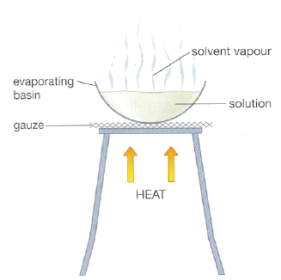
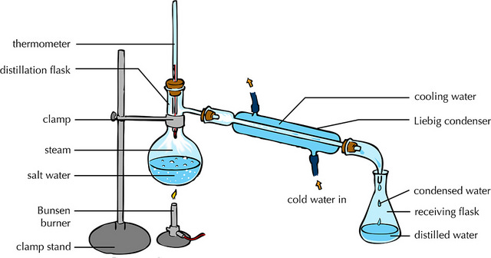
  Atoms, elements, compounds and mixtures - PART 2
Crystallisation Simple distillation
This technique separates a soluble substance from a solvent by evaporation
This technique separates a liquid from a mixture by evaporation follow by condensation
Example - crystallisation of sodium chloride from salt solution
Example - obtaining water from sea water

Slide 19
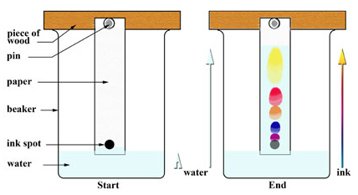
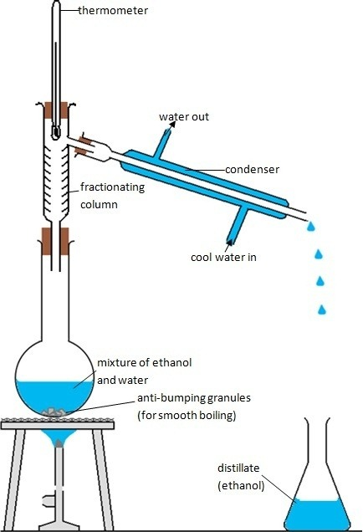
  Atoms, elements, compounds and mixtures - PART 2
Fractional distillation Chromatography
This technique separates a mixture into a number of different parts, called fractions. Substances with high boiling points condense at the bottom and substances with low boiling points condense at the top.
Fractional distillation works because the different substances in the mixture have different boiling points.
This technique separates small amounts of dissolved substances by running a solvent along absorbent paper
Example - obtaining ethanol from a mixture of ethanol and water
Example - separating the different colours in ink
Notes:
https://qph.ec.quoracdn.net/main-qimg-171088c70ca34c66600fb6b1a115fc62-c
http://www.micromountain.com/sci_diagrams/sci_app/sci_app_assets/ctography_lab_eng.jpg

Slide 20
QuestionIT!
Atoms, elements,
compounds and mixtures
PART 2
  Mixtures

Slide 21
  Atoms, elements, compounds and mixtures PART 2 – QuestionIT
What is the difference between a compound and a mixture?
Describe the method used to collect the salt from a mixture of sand and salt.
What process is used to purify seawater to obtain usable water?

Slide 22
  Atoms, elements, compounds and mixtures PART 2 – QuestionIT
4. Describe how the following equipment is used to separate water
and ethanol.

Slide 23
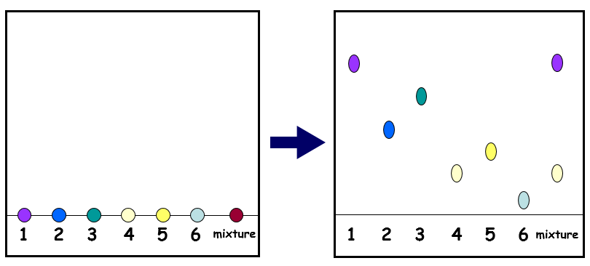
  Atoms, elements, compounds and mixtures PART 2 – QuestionIT
A mixture and six colours are tested using chromatography. The following chromatogram was produced.
a) What can you conclude about the mixture?
b) Why do the inks separate?

Slide 24
AnswerIT!
Atoms, elements,
compounds and mixtures
PART 2
  Mixtures

Slide 25
  Atoms, elements, compounds and mixtures PART 2 – QuestionIT
What is the difference between a compound and a mixture?
The substances in a mixture are not chemically bonded together,
but they are in a compound.
2. Describe the method used to collect the salt from a mixture of
sand and salt.
Add water and stir to dissolve the salt. Use filtration to remove
the sand. Heat the water (gently) to allow the salt to crystallise
(to avoid dryness).
3. What process is used to purify seawater to obtain usable water?
Simple distillation.

Slide 26
  Atoms, elements, compounds and mixtures PART 2 – QuestionIT
4. Describe how the following equipment is used to separate water
and ethanol.
The ethanol and water mixture are heated. Ethanol has a boiling point of 78°C and will vaporise first. The gas passes over the fractionating column and into the condenser. Here it will condense, turning back into it’s liquid state.

Slide 27
  Atoms, elements, compounds and mixtures PART 2 – QuestionIT
A mixture and six colours are tested using chromatography. The following chromatogram was produced:
a) What can you conclude about the mixture?
The mixture is made up from substance 1 and 4.
b) Why do the inks separate to produce a chromatogram?
The separation depends on how soluble the chemical is in the
solvent and how strongly the chemical is attracted to the paper.

Slide 28
LearnIT!
KnowIT!
Atomic model
PART 1
  Development of the atomic model

Slide 29
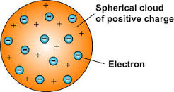
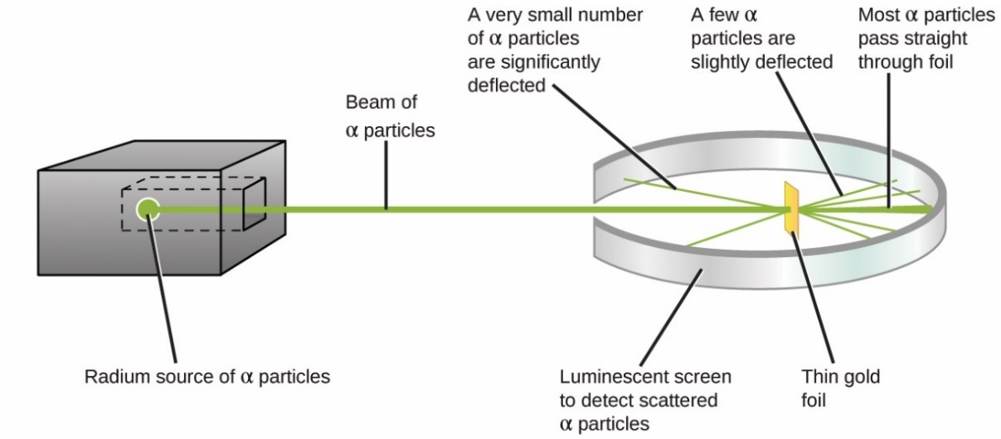
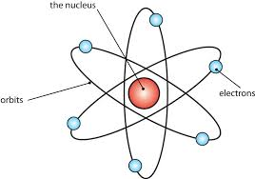
  Atomic model - PART 1
Early 1800s
Before the discovery of electrons, John Dalton’s experiments led to the idea that atoms were tiny spheres that could not be divided.
End of 1800s
The electron was discovered by JJ Thomson. Scientists believed
that atoms were spheres of positive charge with negative
charges spread throughout - the ‘plum-pudding’ model.
1908-1913
Ernst Rutherford designed an experiment carried out by Geiger and Marsden. They fired alpha particles at a piece of very thin gold foil (only a few atoms thick) which scattered, leading to the conclusion that the
mass of an atom was concentrated in a nucleus,
which was charged.
It proposed that electrons orbited
around the nucleus.

Slide 30
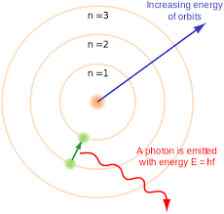
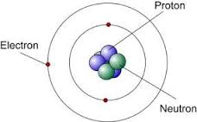
  Atomic model - PART 1
1914
Niels Bohr noticed that the light given out when atoms were heated only had specific amounts of energy and he adapted the nuclear model by suggesting that electrons orbit the nucleus at specific distances in certain fixed energy levels (or shells). The energy must be given out when excited electrons fall from a high to low energy level.
Later experiments led to the idea that the positive charge of the nucleus could be subdivided into a whole number of smaller particles, each particle having the same amount of positive charge. The name proton was given to these particles.
1932
James Chadwick bombarded beryllium atoms with alpha particles. An unknown radiation was produced. Chadwick interpreted this radiation as being composed of particles with a neutral electrical charge and the approximate mass of a proton. This particle became known as the neutron.

Slide 31
  Atomic model - PART 1
1800s
John Dalton – tiny spheres that could not be divided.
1890s
JJ Thomson – electron discovered. Plum pudding model - spheres of positive charge with negative charges spread evenly though.
1908 -1913
E. Rutherford, Geiger and Marsden - alpha particle scattering experiment. Nuclear model - mass of atom concentrated in a charged nucleus, with orbiting electrons.
1914
Niels Bohr – electrons orbit nucleus at specific distances in fixed energy levels (shells). Energy given out when electrons change level.
Later…
Positive charge of nucleus could be subdivided into particles of positive charge – protons.
1932
James Chadwick – provided evidence for the existence of neutrons within the nucleus.

Slide 32
QuestionIT!
Atomic model
PART 1
  Development of the atomic model

Slide 33
  Atomic model PART 1 – QuestionIT
What was the earliest model of the atom?
Which subatomic particle did JJ. Thomson discover?
Which early atomic model does the following diagram show?
Name Rutherford’s experiment.
State two ways in which Rutherford’s experiment changed Thomson’s model of the atom.
How did Bohr adapt the nuclear model?
Explain why Bohr revised Rutherford’s model of the atom.

Slide 34
AnswerIT!
Atomic model
PART 1
  Development of the atomic model

Slide 35
  Atomic model PART 1 – QuestionIT
What was the earliest model of the atom?
Tiny spheres that could not be divided.
Which subatomic particle did JJ. Thomson discover?
The electron
3. Which early atomic model does the following diagram show?
The plum pudding model.
Name Rutherford’s experiment.
Alpha particle scattering.
State two ways in which Rutherford’s experiment changed Thomson’s model of the atom.
He said the positive charge was concentrated into very small
volume at centre of atom (nucleus) and the electrons orbit
nucleus.

Slide 36
  Atomic model PART 1 – QuestionIT
Explain why Bohr revised Rutherford’s model of the atom.
Suggesting electrons orbit the nucleus at different distances.
Explain why Bohr revised Rutherford’s model of the atom.
Energy emitted from electron transitions can only have certain
fixed energies, so he refined the ‘orbiting electrons’ in
Rutherford’s nuclear model to ‘orbiting electrons in energy levels
(or shells) at fixed distances from the nucleus’.

Slide 37
LearnIT!
KnowIT!
Atomic model
PART 2
  Relative electrical charges of subatomic particles.
  Size and mass of atoms
  Atomic structure

Slide 38
  Atomic model - PART 2
Subatomic particles
 | Mass | Charge | Location
Proton | 1 | + | nucleus
Neutron | 1 | 0 | nucleus
Electron | Very small | - | shells
An atom contains equal numbers of protons and electrons.
Atoms have no overall electrical charge because the number of positive protons equals the number of negative electrons.
Number of protons = atomic number.
All atoms of an element have the same number of protons.
Atoms of different elements have different numbers of protons.

Slide 39
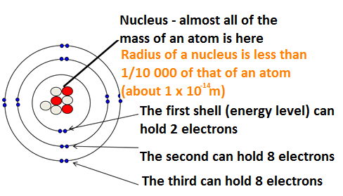
  Atomic model - PART 2
Atoms are very small, having a radius of about 0.1nm (1 x 10 ^{-10m}).
Protons and Neutrons are found in the nucleus. Electrons orbit the nucleus in shells.
Mass number = Number of protons and neutrons
7
Protons = 3
Electrons = 3
Neutrons = 4
Li
Atomic number = Number of protons
3
To calculate the number of neutrons = Mass Number – Atomic Number

Slide 40
  Atomic model - PART 2
Atoms sometimes lose or gain electrons (e.g. when a metal reacts with a none metal). When they do this they become a charge atom or an ion.
If an atom loses one or more electrons, it gains a positive charge because it has less electrons than protons.
If an atom gains one or more electrons, it gains a negative charge because it has more electrons than protons.
e.g. If sodium atom loses one electron, it forms a Na⁺ ion.
It has 11 protons, 12 neutrons and 10 electrons.
e.g. If an oxygen atom gains two electrons, it forms a O²⁻ ion.
It has 8 protons, 8 neutrons and 10 electrons.

Slide 41
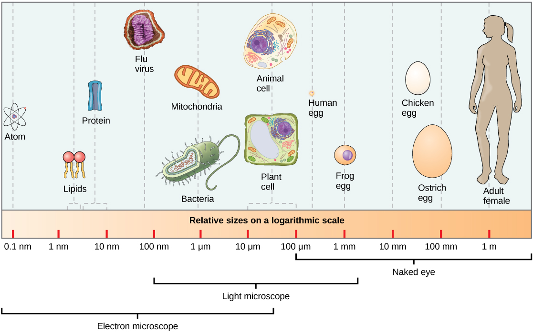
Atoms are tiny - the radius of a typical atom is one tenth of a billionth of a meter.

Slide 42
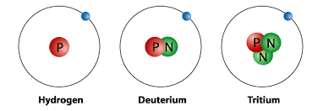
  Atomic model - PART 2
Atoms of the same element can have different numbers of neutrons – an isotope.
Isotopes of Hydrogen
The relative atomic mass of an element is an average value that takes account of the abundance of the isotopes of the element. Samples of different isotopes of an element have different physical properties (e.g. different density), however, they always have the same chemical properties. It is calculated by working out the relative abundance of each isotope.
The relative atomic mass is therefore calculated using the equation:
(% of isotope 1 × mass of isotope 1) + (% of isotope 2 × mass of isotope 2) ÷ 100
Chlorine’s relative atomic mass of 35.5 is an average of the masses of the different isotopes of chlorine.
For example, in any sample of Chlorine 25% will be ³⁷Cl and 75% ³⁵Cl.
(25 x 37) + (75 x 35) ÷ 100 = 35.5

Slide 43
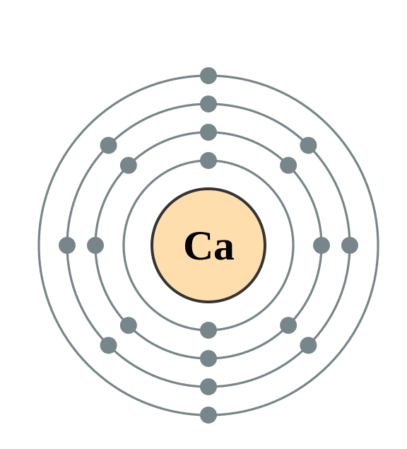
  Atomic model - PART 2
The electrons in an atom occupy the lowest available energy levels (innermost available shells). The electronic structure of an atom can be represented by numbers or by a diagram e.g.
Calcium has 2 electrons on its lowest energy level,
8 on the second energy level,
8 on the third energy level
and 2 on the fourth (the highest) energy level.
So the electron configuration for Calcium = 2,8,8,2

Slide 44
QuestionIT!
Atomic model
PART 2
  Relative electrical charges of subatomic particles.
  Size and mass of atoms
  Atomic structure

Slide 45
  Atomic model PART 2 – QuestionIT
Name three subatomic particles and their charges.
Complete the sentence ‘All atoms of one type of element have the same number of…’
What does the atomic number tell us about an atom?
What does the mass number tell us about an atom?
How is an isotope different to an atom?
What is the electron configuration for sodium?

Slide 46
  Atomic model PART 2 – QuestionIT
Why is the overall charge of an atom zero?
Draw the electron configuration for a chlorine atom.
Write the electron configuration for potassium.
How many electrons does potassium have on its highest energy level?

Slide 47

  Atomic model PART 2 – QuestionIT
Calculate how many protons, electrons and neutrons there are in
a) A silver atom with atomic number 47 and mass number 108
b)
The atomic radius of a bromine atom is 9 x 10 ⁻¹¹m
a) Give its atomic radius in nanometres
b) Calculate the radius of the nucleus (in nm), given that it will be
about 1/10,000 the radius of the atom. Give your answer in
standard form.

Slide 48
AnswerIT!
Atomic model
PART 2
  Relative electrical charges of subatomic particles.
  Size and mass of atoms
  Atomic structure

Slide 49
  Atomic model PART 2 – QuestionIT
Name three subatomic particles and their charges.
  Proton – positive; neutron – no charge; electron – negative.
Complete the sentence ‘All atoms of one type of element have the same number of…’
  Protons.
What does the atomic number tell us about an atom?
  Number of protons.
What does the mass number tell us about an atom?
  Number of protons + number of neutrons.
How is an isotope different to an atom?
  Different number of neutrons.
What is the electron configuration for sodium?
  2,8,1

Slide 50
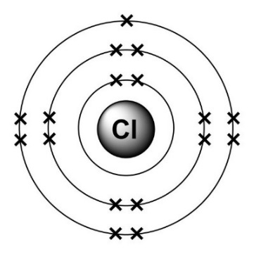
  Atomic model PART 2 – QuestionIT
Why is the overall charge of an atom zero?
  Number of protons (positive) = number electrons (negative).
Draw the electron configuration for a chlorine atom.
Write the electron configuration for potassium.
  2,8,8,1
How many electrons does potassium have on its highest energy level?
  1

Slide 51
  Atomic model PART 2 – QuestionIT
Calculate how many protons, electrons and neutrons there are in:
a) A silver atom with atomic number 47 and mass number 108
Protons = 47 Electrons = 47 Neutrons = 61
b)
Protons = 19 Electrons = 18 Neutrons = 20
12. The atomic radius of a bromine atom is 9 x 10 ⁻¹¹m
a) Give its atomic radius in nanometres.
0.09 nm
b) Calculate the radius of the nucleus (in nm), given that it will be
about 1/10,000 the radius of the atom. Give your answer in
standard form.
9 × 10⁻⁶nm

Slide 52
LearnIT!
KnowIT!
Periodic table
PART 1
  The periodic table
  Development of the periodic table
  Metals and non-metals

Slide 53
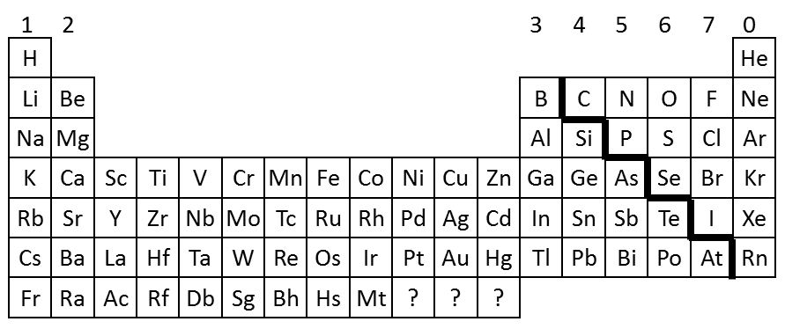
  Periodic table - PART 1
The elements are arranged in order of increasing atomic number.
Elements with similar properties are in columns, known as groups.
Elements in the same group have the same number of electrons in their outer shell.
It is called a periodic table because similar properties occur at regular intervals
The rows in the table are called periods
Group = electrons in outer shell
Period = number of shells
Group = 7
Period = 3

Slide 54
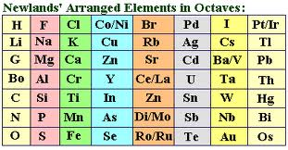
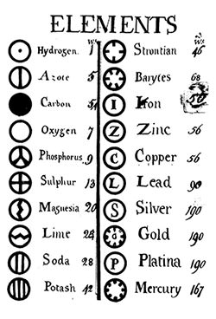
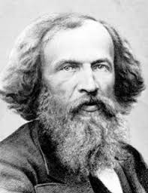
  Periodic table - PART 1
1864
John Newlands published the law of octaves. However the table was incomplete and elements were placed in inappropriate groups
1808
John Dalton published a table of elements that were arranged in order of their atomic weights, which had been measured in various chemical reactions
1869
Dmitri Mendeleev overcame Dalton’s problem by leaving gaps for the elements that he thought had not been discovered and in some places changed the order based on atomic weight (e.g. Argon and Potassium). Elements with properties predicted by Mendeleev were eventually discovered.
Early20th Century - Scientists began to find out more about the atom and knowledge of isotopes explained why the order was not always correct.

Slide 55
  Periodic table - PART 1
The elements can be divided into metals and non-metals.
1
2
H
3
4
5
6
7
0
Elements that do not form positive ions are non-metals
Elements that tend to form positive ions are metals
He
Li
Be
B
C
N
O
F
Ne
Na
Mg
Al
Si
P
S
Cl
Ar
K
Ca
Sc
Ti
V
Cr
Mn
Fe
Co
Ni
Cu
Zn
Ga
Ge
As
Se
Br
Kr
Rb
Sr
Y
Zr
Nb
Mo
Tc
Ru
Rh
Pd
Ag
Cd
In
Sn
Sb
Te
I
Xe
Cs
Ba
La
Hf
Ta
W
Re
Os
Ir
Pt
Au
Hg
Tl
Pb
Bi
Po
At
Rn
Non metals – found towards the right and towards the top of the periodic table
Fr
Ra
Ac
Rf
Db
Sg
Bh
Hs
Mt
?
?
?
Metals | Non-metals
Shiny Mostly solid Dense and strong Malleable Good heat and electrical conductors | Dull Low density Weak Brittle Poor heat and electrical conductors
Most elements are metals – found towards the left and towards the bottom of the periodic table

Slide 56
QuestionIT!
Periodic table
PART 1
  The periodic table
  Development of the periodic table
  Metals and non-metals

Slide 57
  Periodic table PART 1 – QuestionIT
How are elements arranged in the periodic table?
What are the columns of the periodic table called?
What are the rows of a periodic table called?
What does the column an element is in tell you about the atoms?
What does the row an element is in tell you about the atoms?
Which side of the periodic table are the non-metals found?

Slide 58
  Periodic table PART 1 – QuestionIT
How were elements classified before the discovery of subatomic particles?
What was the problem with early periodic tables?
How did Mendeleev overcome these problems?
Why is the order based on atomic masses not always correct?
What do we call elements that tend to form positive ions?

Slide 59
AnswerIT!
Periodic table
PART 1
  The periodic table
  Development of the periodic table
  Metals and non-metals

Slide 60
  Periodic table PART 1 – QuestionIT
How are elements arranged in the modern periodic table?
  Increasing atomic number.
What are the columns of the periodic table called?
  Groups.
What are the rows of a periodic table called?
  Periods.
What does the column an element is in tell you about the atoms?
  Number of electrons in outer shell.
What does the row an element is in tell you about the atoms?
  Number of electron shells.

Slide 61
  Periodic table PART 1 – QuestionIT
Which side of the periodic table are the non-metals found?
  Right and top.
How were elements classified before the discovery of subatomic particles?
  Arranging in order of their atomic weights.
What was the problem with early periodic tables?
  Incomplete; some elements placed in inappropriate groups.
How did Mendeleev overcome these problems?
  Left gaps for elements he thought had not yet been discovered; changed the order based on atomic weights for some elements if they did not fit the pattern.

Slide 62
  Periodic table PART 1 – QuestionIT
Why is the order based on atomic masses not always correct?
  The presence of isotopes.
What do we call elements that tend to form positive ions?
  Metals.

Slide 63
LearnIT!
KnowIT!
Periodic table
PART 2
  Group 0, Group 1
  and Group 7

Slide 64
  Periodic table - PART 2
THE NOBLE GASES
1
2
3
4
5
6
7
0
H
He
Li
Be
B
C
N
O
F
Ne
Na
Mg
Al
Si
P
S
Cl
Ar
K
Ca
Sc
Ti
V
Cr
Mn
Fe
Co
Ni
Cu
Zn
Ga
Ge
As
Se
Br
Kr
Rb
Sr
Y
Zr
Nb
Mo
Tc
Ru
Rh
Pd
Ag
Cd
In
Sn
Sb
Te
I
Xe
Cs
Ba
La
Hf
Ta
W
Re
Os
Ir
Pt
Au
Hg
Tl
Pb
Bi
Po
At
Rn
Fr
Ra
Ac
Rf
Db
Sg
Bh
Hs
Mt
?
?
?
Elements in Group 0 of the periodic table are called the noble gases. They are unreactive because their atoms have stable arrangements of electrons. The atoms have eight electrons in their outermost shell, apart from helium, which has just two, but still has a complete outer shell.
The stable electronic structure explains why they exist as single atoms, they have no tendency to react to form molecules.
The boiling points of the noble gases get higher going down the group. For example helium boils at -269 °C and radon boils at -62°C.

Slide 65
  Periodic table - PART 2
1
2
3
4
5
6
7
0
H
He
Li
Be
B
C
N
O
F
Ne
THE ALKALI METALS
Na
Mg
Al
Si
P
S
Cl
Ar
K
Ca
Sc
Ti
V
Cr
Mn
Fe
Co
Ni
Cu
Zn
Ga
Ge
As
Se
Br
Kr
Rb
Sr
Y
Zr
Nb
Mo
Tc
Ru
Rh
Pd
Ag
Cd
In
Sn
Sb
Te
I
Xe
Cs
Ba
La
Hf
Ta
W
Re
Os
Ir
Pt
Au
Hg
Tl
Pb
Bi
Po
At
Rn
Fr
Ra
Ac
Rf
Db
Sg
Bh
Hs
Mt
?
?
?
The alkali metals are very reactive. They need to be stored under oil to prevent them reacting with oxygen and water vapour in the air. The alkali metals have low densities. The metals are very soft and can be cut with a knife. They also have low melting and boiling points.
The properties are due to all the atoms having just one electron in their outermost shell. They only need to lose one electron to get the stable electronic structure of a noble gas.
The atoms get larger as you go down, so the single electron in the outermost shell (highest energy level) is attracted less strongly to the positive nucleus. The electrostatic attraction with the nucleus gets weaker because the distance between the outer electron and the nucleus increases. Also the outer electron experiences a shielding effect from the inner electrons, reducing the attraction between the oppositely charged outer electron and the nucleus.
Li
Reactivity
Increases
Na
K
Rb
Cs

Slide 66
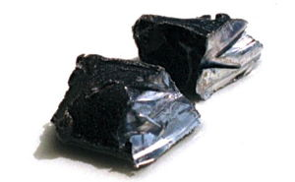
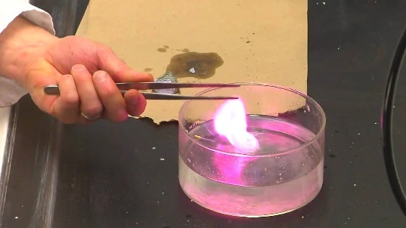
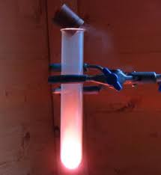
  Periodic table - PART 2
The alkali metals have a silvery, shiny surface when they are first cut. However, this goes dull very quickly as the metals reacts with the oxygen in the air.
e.g. sodium + oxygen → sodium oxide
4Na(s) + O₂(g) → 2Na₂O(s)
Lithium, sodium and potassium all react vigorously with water. When you add them to water, the metal floats, moves around and fizzes.
e.g. potassium + water → potassium hydroxide + hydrogen
2K(s) + 2H₂O(l) → 2KOH(aq) + H₂(g)
Potassium ignites with a lilac flame
They also react vigorously with non metals, such as group seven. They form 1+ ions in the reactions to make ionic compounds. These are generally white and dissolve in water, giving colourless solutions.
e.g. sodium + chlorine → sodium chloride
2Na(s) + Cl₂(g) → 2NaCl(s)
shiny
metal
oxide

Slide 67
  Periodic table - PART 2
1
2
3
4
5
6
7
0
THE HALOGENS
H
He
Li
Be
B
C
N
O
F
Ne
Na
Mg
Al
Si
P
S
Cl
Ar
When Group 7 elements react, the atoms gain an electron in their outermost shell. Going down the group, the outermost shell’s electrons get further away from the attractive force of the nucleus, so it is harder to attract and gain an extra electron. The outer shell will also be shielded by more inner shells of electrons, again reducing the electrostatic attraction of the nucleus for an incoming electron.
K
Ca
Sc
Ti
V
Cr
Mn
Fe
Co
Ni
Cu
Zn
Ga
Ge
As
Se
Br
Kr
Rb
Sr
Y
Zr
Nb
Mo
Tc
Ru
Rh
Pd
Ag
Cd
In
Sn
Sb
Te
I
Xe
Cs
Ba
La
Hf
Ta
W
Re
Os
Ir
Pt
Au
Hg
Tl
Pb
Bi
Po
At
Rn
Fr
Ra
Ac
Rf
Db
Sg
Bh
Hs
Mt
?
?
?
The halogens are a group of toxic non-metals that have coloured vapours. They have low melting and boiling points, which increase down the group. They are poor conductors of heat and electricity.
As elements, the halogens exist as molecules made up of pairs of atoms. These are called diatomic molecules F₂, Cl₂, Br₂, I₂ and At₂. The halogens have seven electrons in their outermost shell and need to gain one electron to achieve the stable electronic structure of a noble gas. When they react with non metals, they are joined together by a covalent bond.
F
Reactivity
Decreases
Cl
Br
I
At

Slide 68
  Periodic table - PART 2
The halogens react with hydrogen. The reactions with hydrogen become less reactive as you go down the group.
e.g. fluorine + hydrogen → hydrogen fluoride
F₂(g) + H₂(g) → 2HF(g)
The halogens also react with metals. The halogen atoms gain a single electron to give them a stable arrangement of electrons. They form ionic compound.
e.g. sodium + chlorine → sodium chloride
2Na(s) + Cl₂(g) → 2NaCl(s)
A more reactive halogen will also displace a less reactive halogen from solutions of its salts.
e.g. chlorine + potassium bromide → potassium chloride + bromine
Cl₂(g) + 2KBr(aq) → 2KCl(aq) + Br₂(aq)
The colour of the solution after mixing depends on the less reactive pair of halogens.
Cl₂(aq) Br₂(aq) I₂(aq)

Slide 69
QuestionIT!
Periodic table
PART 2
  Group 0, Group 1
  and Group 7

Slide 70
  Periodic table PART 2 – QuestionIT
What are the elements in Group 0 called?
What are the elements in Group 1 called?
What are the elements in Group 7 called?
What happens to the boiling point of elements in Group 0 as you go down the group?
Why are the elements in Group 0 so unreactive?
Why do all elements in Group 1 react in a similar way to each other?

Slide 71
  Periodic table PART 2 – QuestionIT
What happens to the reactivity of the elements as you go down Group 1?
Write a word equation for the reaction between sodium and oxygen.
Why do all the elements in Group 7 react in a similar way to each other?
Halogens are diatomic. What does the word ‘diatomic’ mean?
What happens to the reactivity as you go down Group 7?

Slide 72
  Periodic table PART 2 – QuestionIT
What happens to the melting point and boiling point as you go down Group 7?
Write a word equation for the reaction between lithium and chlorine.
Write a balanced chemical equation for the reaction between lithium and chlorine gas.

Slide 73
AnswerIT!
Periodic table
PART 2
  Group 0, Group 1
  and Group 7

Slide 74
  Periodic table PART 2 – QuestionIT
What are the elements in Group 0 called?
  Noble gases.
What are the elements in Group 1 called?
  Alkali metals.
What are the elements in Group 7 called?
  Halogens.
What happens to the boiling point of elements in Group 0 as you go down the group?
  Increase.
Why are the elements in Group 0 so unreactive?
  Full outer shell of electrons.
Why do all elements in Group 1 react in a similar way to each other?
  1 electron in outer shell.

Slide 75
  Periodic table PART 2 – QuestionIT
What happens to the reactivity of the elements as you go down Group 1?
  Increases.
Write a word equation for the reaction between sodium and oxygen.
  sodium + oxygen → sodium oxide
Why do all the elements in Group 7 react in a similar way to each other?
  7 electrons in outer shell.
Halogens are diatomic. What does the word ‘diatomic’ mean?
  There molecules contain 2 atoms.
What happens to the reactivity as you go down Group 7?
  Decreases.

Slide 76
  Periodic table PART 2 – QuestionIT
What happens to the melting point and boiling point as you go down Group 7?
  Increases.
Write a word equation for the reaction between lithium and chlorine.
  lithium + chlorine → lithium chloride
Write a balanced chemical equation for the reaction between lithium and chlorine gas.
  2Li(s) + Cl₂(g) → 2LiCl(s)

Slide 77
LearnIT!
KnowIT!
Periodic table
PART 3
  Transition Metals
  (chemistry only)

Slide 78
  Periodic table - PART 3
  Chemistry only
THE TRANSITION METALS
The transition metals are located between group 2 and group 3.
The transition metals have:
High melting points
High boiling points
High densities
They are:
Shiny when polished
Malleable – can be hammered into a shape
Strong – don’t break easily when a force is applied
Sonorous – makes a ringing sound when hit
Ductile – can be stretched into wires
Conductors of electricity and heat
1
2
3
4
5
6
7
0
H
He
Li
Be
B
C
N
O
F
Ne
Na
Mg
Al
Si
P
S
Cl
Ar
K
Ca
Sc
Ti
V
Cr
Mn
Fe
Co
Ni
Cu
Zn
Ga
Ge
As
Se
Br
Kr
Rb
Sr
Y
Zr
Nb
Mo
Tc
Ru
Rh
Pd
Ag
Cd
In
Sn
Sb
Te
I
Xe
Cs
Ba
La
Hf
Ta
W
Re
Os
Ir
Pt
Au
Hg
Tl
Pb
Bi
Po
At
Rn
Fr
Ra
Ac
Rf
Db
Sg
Bh
Hs
Mt
?
?
?
Reactivity decreases
The general trend is the reactivity decreases across the period, but there are exceptions, for example Zinc is very reactive.
Sc
Ti
V
Cr
Mn
Fe
Co
Ni
Cu
Zn

Slide 79
  Periodic table - PART 3
  Chemistry only
1
2
3
4
5
6
7
0
H
He
Transition metals have different properties compared to the alkali metals (group 1).
Li
Be
B
C
N
O
F
Ne
Na
Mg
Al
Si
P
S
Cl
Ar
K
Ca
Sc
Ti
V
Cr
Mn
Fe
Co
Ni
Cu
Zn
Ga
Ge
As
Se
Br
Kr
Rb
Sr
Y
Zr
Nb
Mo
Tc
Ru
Rh
Pd
Ag
Cd
In
Sn
Sb
Te
I
Xe
Cs
Ba
La
Hf
Ta
W
Re
Os
Ir
Pt
Au
Hg
Tl
Pb
Bi
Po
At
Rn
Fr
Ra
Ac
Rf
Db
Sg
Bh
Hs
Mt
?
?
?
 | Alkali metals | Transition metals
Melting points | Low | High (except mercury, which is liquid at room temperature)
Reactivity | High (react vigorously with water or oxygen) | Low (do not react so vigorously with water or oxygen)
Strength | Soft or liquid so cannot withstand force | Strong and hard
Density | Low | High
Compounds formed | White or colourless | Coloured

Slide 80
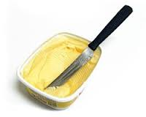
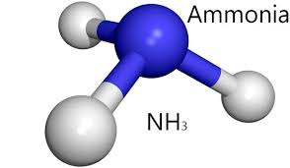
  Periodic table - PART 3
  Chemistry only
The transition metals have many different uses due to their properties. Copper has properties that make it useful for electrical wiring and plumbing. Not very reactive, excellent conductor of electricity, easily bent into shape for water pipes in plumbing.
They can also be useful as catalysts. A catalyst is a substance that speeds up a chemical reaction without being used up. Catalysts are hugely valuable in industry where they can save time and energy.
Nickel is the catalyst used in the hydrogenation of oil to produce margarine
Iron is the catalyst used in the Haber process to produce ammonia

Slide 81
QuestionIT!
Periodic table
PART 3
  Transition Metals
  (chemistry only)

Slide 82
  Periodic table PART 3 – QuestionIT
Where are transition metals found on the periodic table?
How do the melting points of transition metals compare to Group 1 metals?
How do the densities of transition metals compare to Group 1 metals?
How does the strength of transition metals compare to Group 1 metals?

Slide 83
  Periodic table PART 3 – QuestionIT
Describe the differences between the reactions of the alkali metals and the reactions of transition metals.
State two typical properties of transition metals.
State one use of transition metals.
Explain why copper is used for plumbing.

Slide 84
AnswerIT!
Periodic table
PART 3
  Transition Metals
  (chemistry only)

Slide 85
  Periodic table PART 3 – QuestionIT
Where are transition metals found on the periodic table?
  Between Group 2 and Group 3.
How do the melting points of transition metals compare to Group 1 metals?
  Transition metals have a higher melting point than alkali metals.
How do the densities of transition metals compare to Group 1 metals?
  Transition metals are more dense than alkali metals.
How does the strength of transition metals compare to Group 1 metals?
  Transition metals are stronger than alkali metals.

Slide 86
  Periodic table PART 3 – QuestionIT
Describe the differences between the reactions of the alkali metals and the reactions of transition metals.
  Alkali metals react vigorously with water and with oxygen from
the air. The transition elements react slowly with these reagents
if at all.
State two typical properties of transition metals.
  Have ions with different charges; form coloured compounds.
State one use of transition metals.
  Transition metals can be used as catalysts.
Explain why copper is used for plumbing.
  It has a high melting point, it conducts heat and is strong and
malleable. It also does not react with water.

